Slide 1
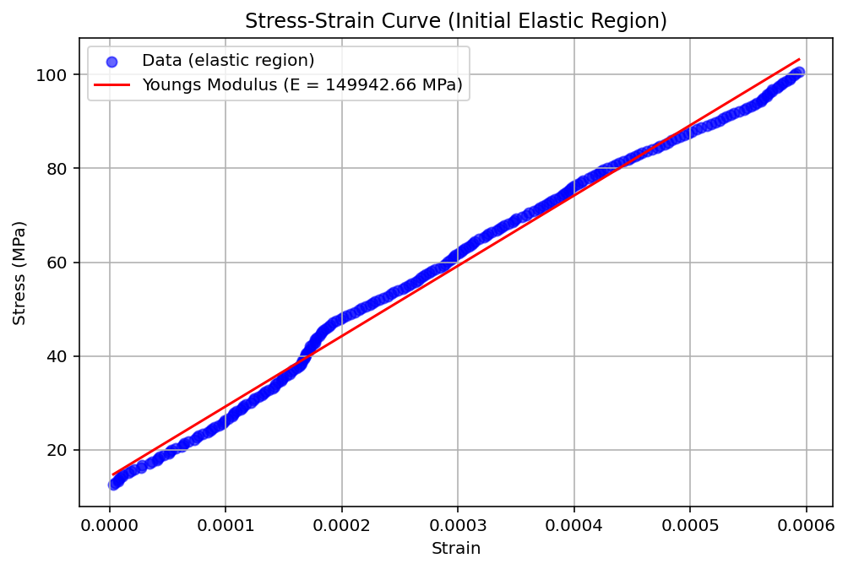

Slide 2
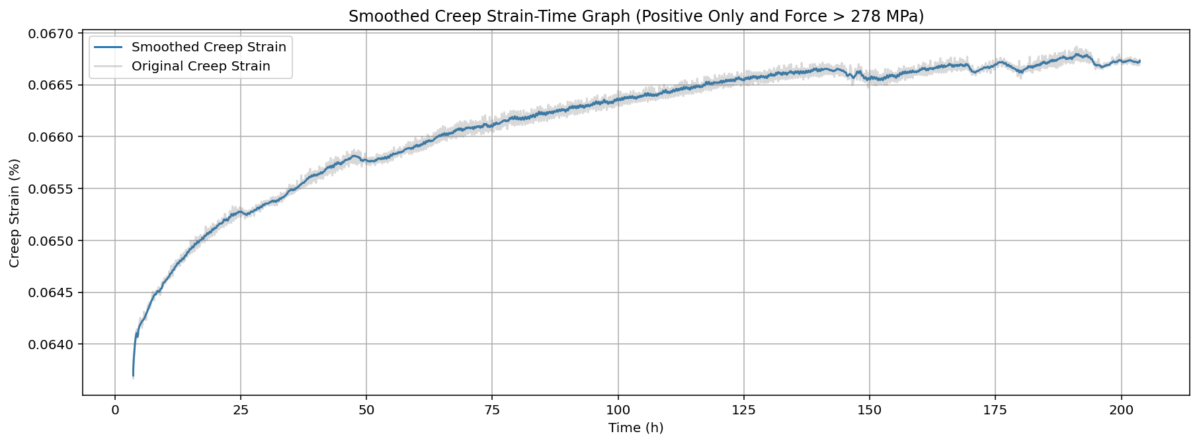

Cropped Strain – Time graph

Slide 3
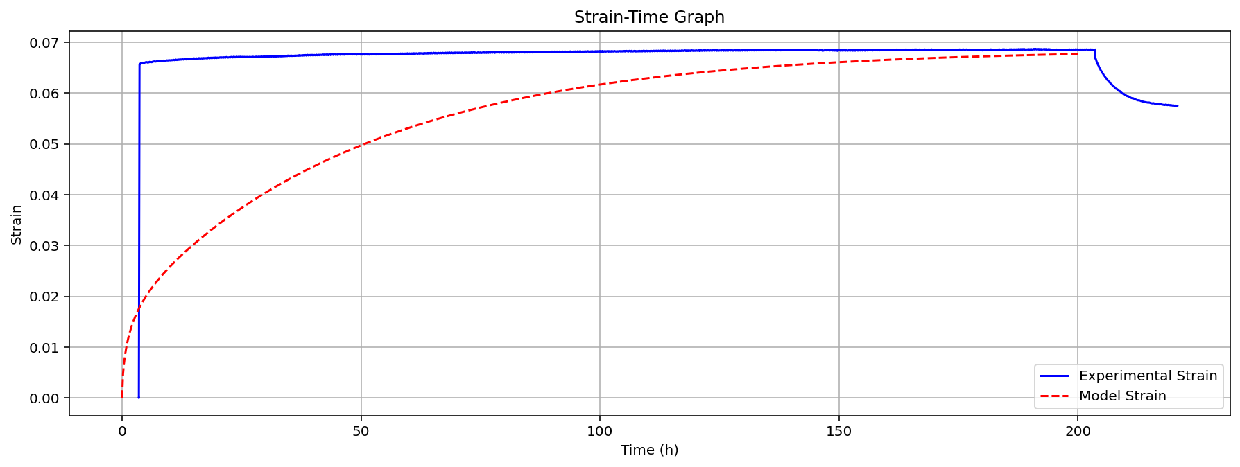
Graph with British Energy model plotted

Slide 4
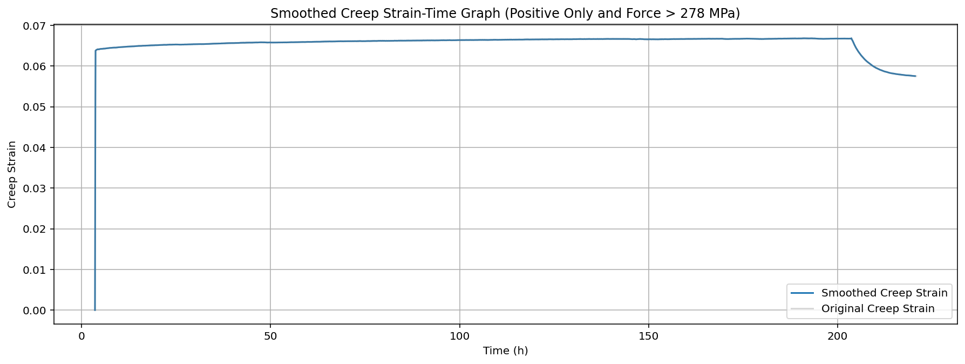
Strain – Time graph for 280MPa

Slide 5
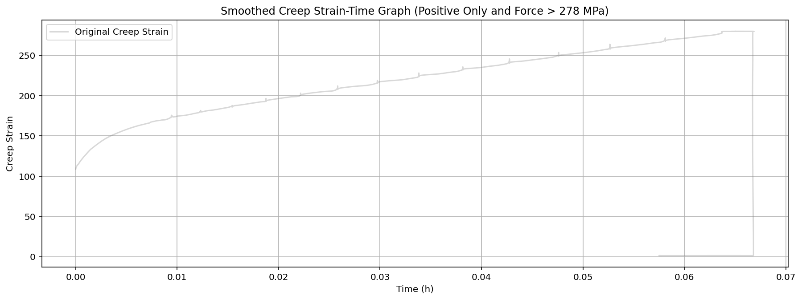
THIS IS STRESS-STRAIN (IGNORE AXIS LABELS)

